Slide 1
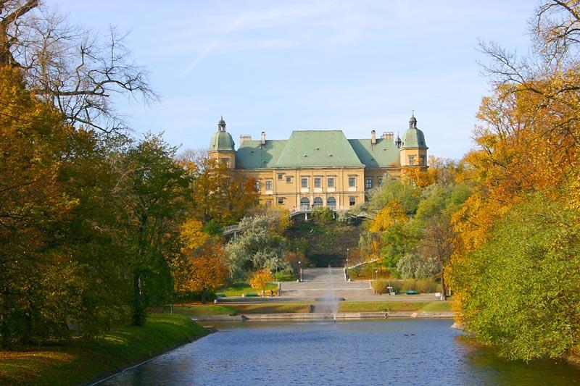
Ujazdów Castle

Slide 2
History
The first castle on the spot was erected by the Dukes of Masovia as early as the 13th century. However, in the following century their property was moved to the future Royal Castle in Warsaw, and the Ujazdów Castle fell into neglect. In the 16th century Queen Bona Sforza built there wooden manor. The ruins of the castle of the Mazovian princes were then incorporated into a new fortified manor built by King Sigismund III Vasa for his son, future King Władysław IV Vasa. Between 1659 and 1665, the building housed the mint of Titus Livius Boratini, who there struck his famous boratynka, a type of solidus coin.

Slide 3
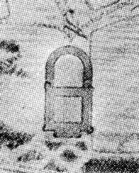

Slide 4
History
In 1674 the castle was bought by Stanisław Herakliusz Lubomirski and then rented to King August II, who ordered the construction there of a new royal residence. The castle, incorporating much of the earlier constructions on the site, was built by Tylman of Gameren. The gardens surrounding the castle, later divided into two separate parks. About that time the Łazienki Eremity and Łazienki Palace were built.

Slide 5
History
Between 1784 and 1789 the castle was rebuilt again, this time by Stanisław Zawadzki, who converted it into military barracks. Since that time the building housed the Lithuanian Foot Guard Regiment and the 10th Foot Regiment. During the Kościuszko's Uprising the castle was the main centre of conscription for the 20th Foot Regiment. After the Partitions of Poland, during the Prussian occupation of Warsaw, the building was abandoned.

Slide 6
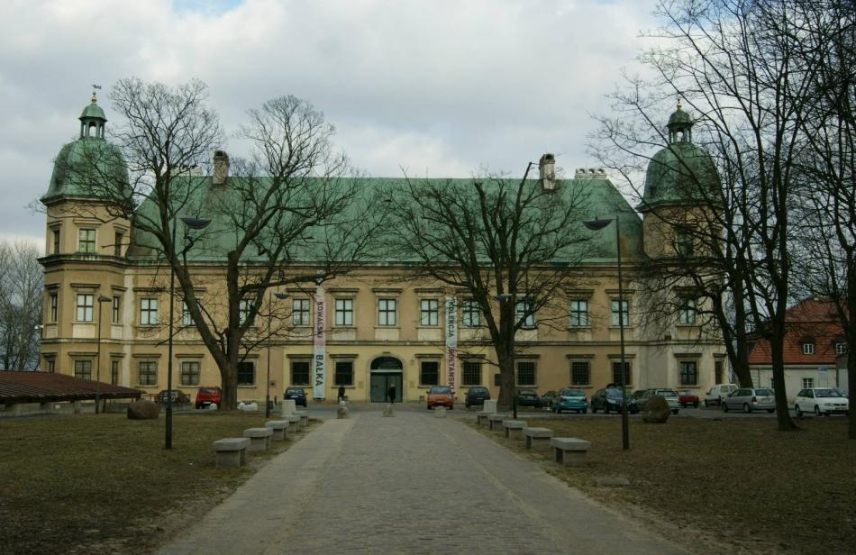

Slide 7
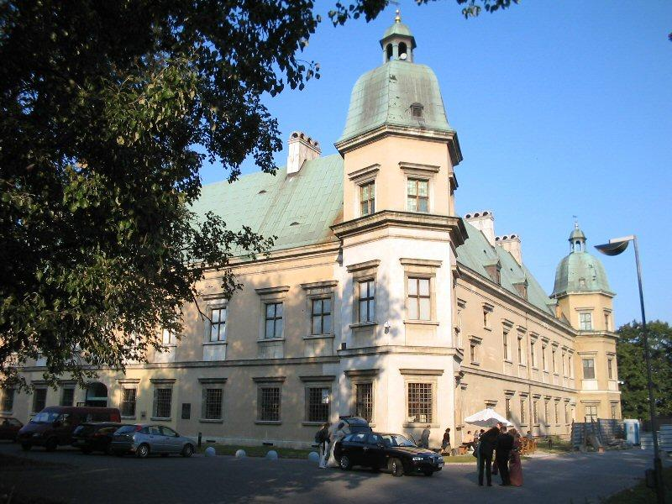

Slide 8
History
After the proclamation of the Duchy of Warsaw it was again restored to the army and was converted into a military hospital. After the fall of the uprising, the Russian garrison of Warsaw was significantly strengthened, while the Polish military units were disbanded. A new central military hospital was built next to what became the Park Ujazdowski and the castle became more of a barrack for the Russian military personnel. Around 1850 the outbuildings were again rebuilt by Jerzy Karol Völck, but were partially demolished 20 years afterwards.

Slide 9
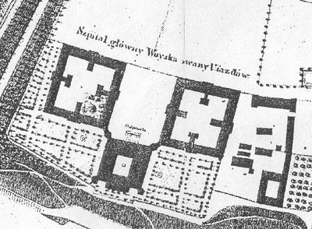

Slide 10
History
After the outbreak of World War I the building was again converted to a provisional hospital by the Russians. Captured by the German army in 1915, on April 10, 1917 it was transferred to the Polish Legions and became the main military hospital for Polish units fighting alongside the Central Powers. After Poland regained her independence in 1918, the internal design of the castle was yet again modified. Since 1920's it housed several parts of the Warsaw NCO school. The main staircase was restored to its 18th century representative design.

Slide 11
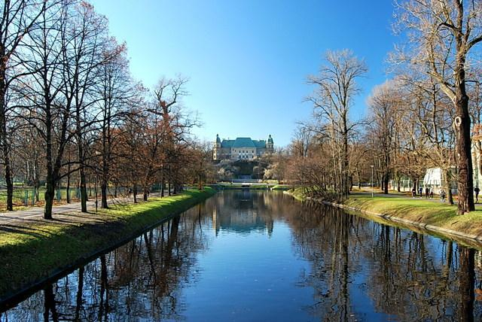

Slide 12
History
An interesting feature of the staircase was a set of stone tablets placed there May 15, 1927, commemorating the names of all known Polish military medics who perished in wars between 1797 and 1920. Additional tablets commemorated Karol Kaczkowski, Zdzisław Lubaszewski and a sculpture by Edward Wittig commemorating all military medics. After the Polish Defensive War of 1939, the Red Cross organized a school for WIA soldiers. The castle was burnt out and damaged by the Germans following the Warsaw Uprising of 1944.

Slide 13
History
After the war the building was to be rebuilt as the Central Military House. However, the works did not start as the walls of the castle were demolished by the Communist authorities of Poland. In 1975 however, the works on reconstruction of the castle to its 18th century design were given a green light and the project by Piotr Biegański was chosen. It houses Warsaw's Center for Contemporary Art since 1985.

Slide 14
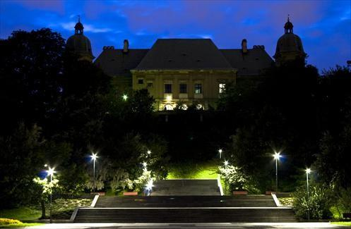

Slide 15
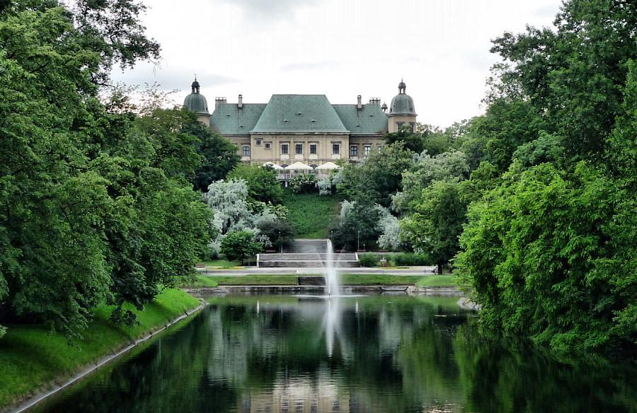

Slide 16
Shape
Castle is constructed on a square plan. When we look at roof in good perspective it look like trapeze. Towers is on corner, and each of them is hexagon.

Slide 17
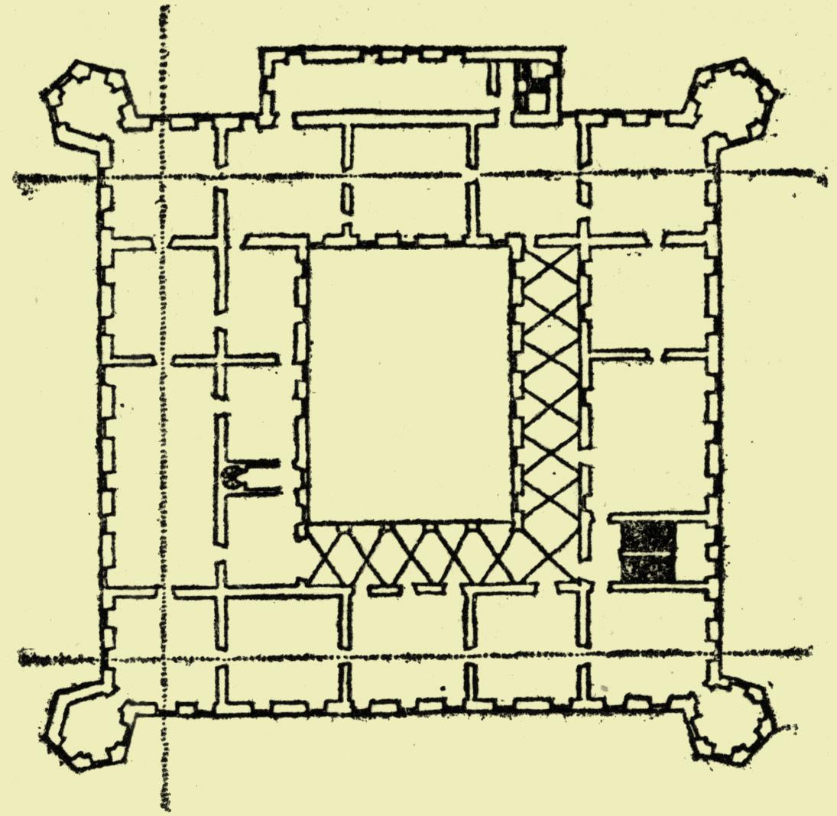

Slide 18
